Slide 1
Who AM I….

Slide 2

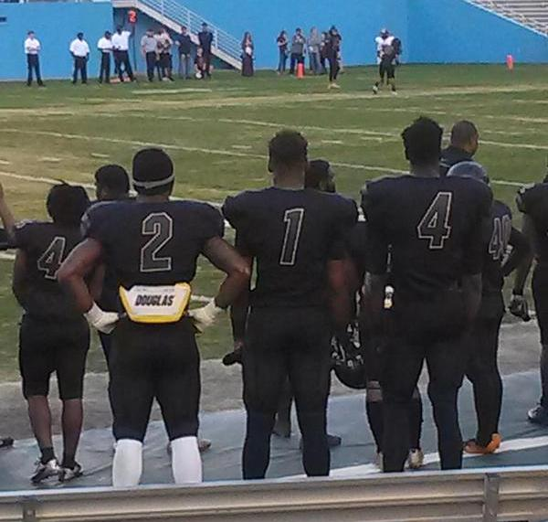
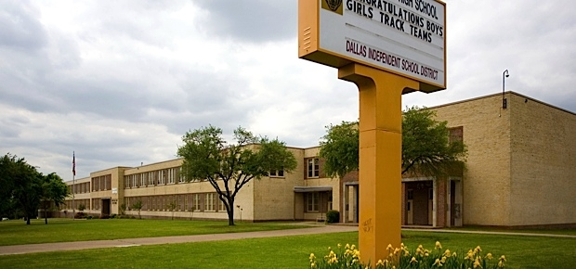
Where I’m from
I’m from Oak Cliff which is a big neighborhood that makes up the city of Dallas not Dallas County.

Slide 3
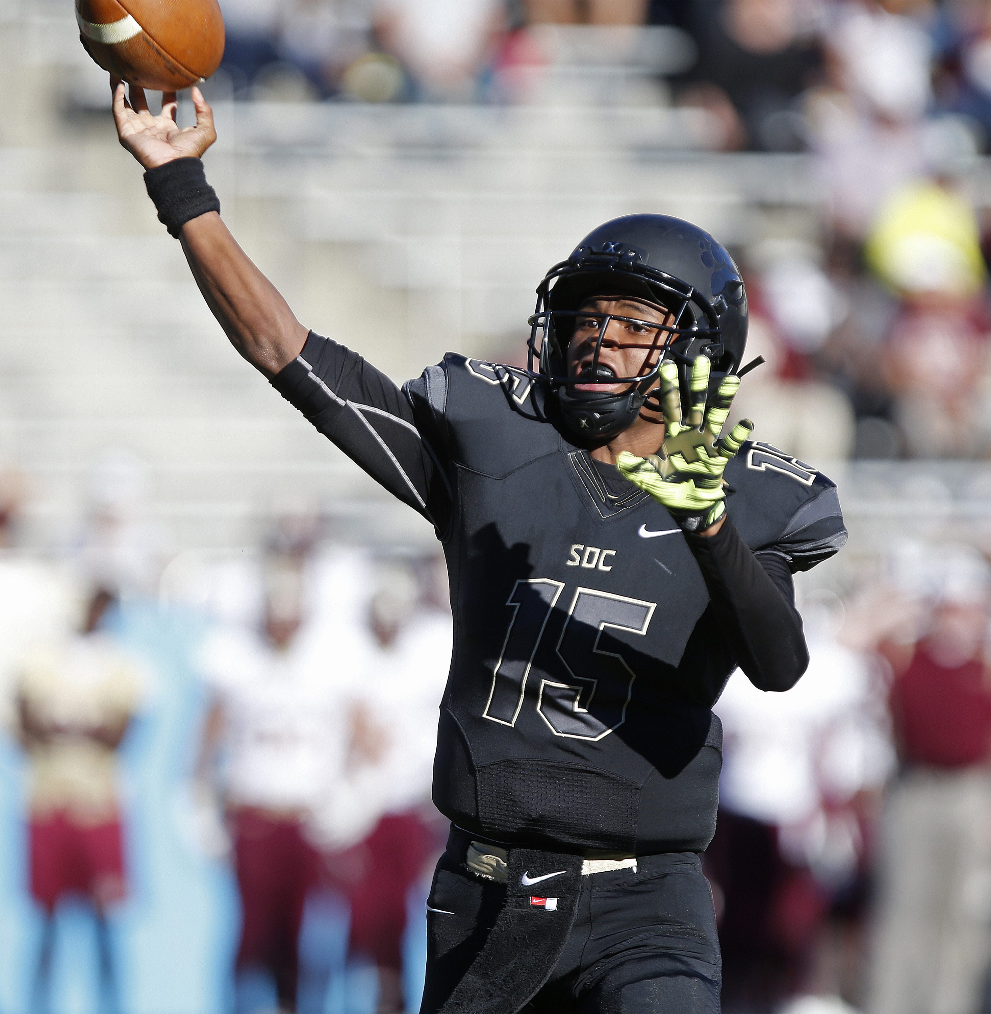
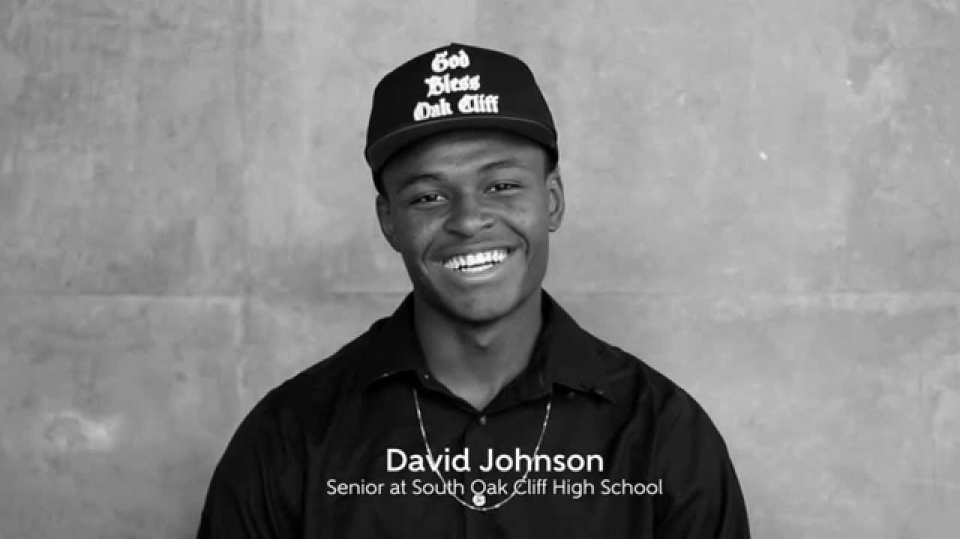
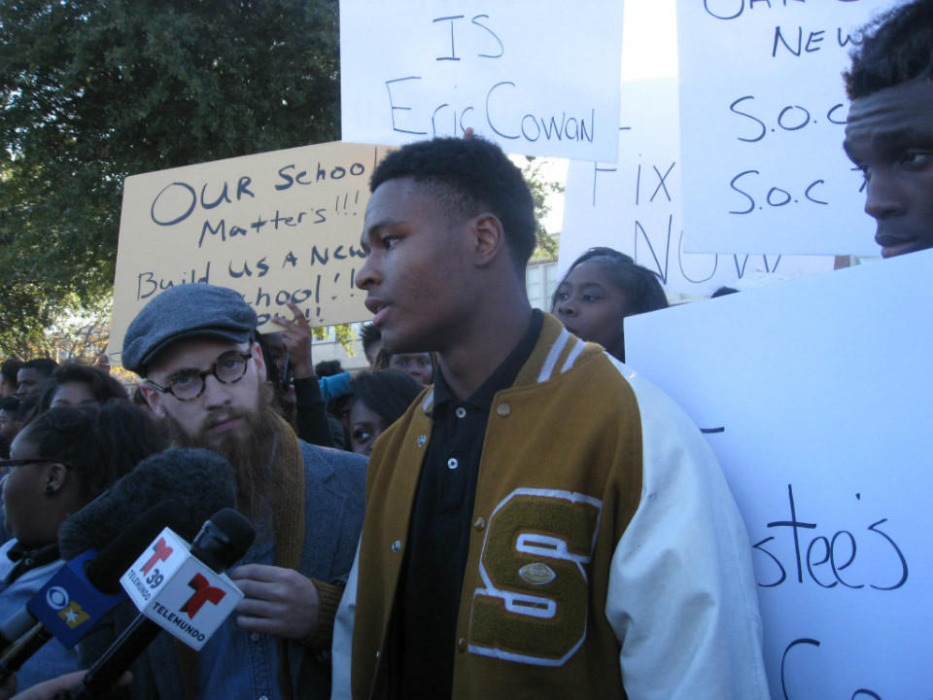
What I like
Play Football, Create Change and Influence for Good

Slide 4


Favorite sports team
#FearTheSpear #SicEmBears

Slide 5
Siblings
I Have One Brother who goes to UT Austin and A Little Sister who a Junior in HS, which makes me the middle child.

Slide 6
What I plan to learn
I plan to learn who to use everything that is listed on the list because I don’t know how to use it. To be a good video producer I know I’ll need to know how to use these things, so I'm willing to learn whatever is need to learn.

